Slide 1

Airlines Performance Dashboard
Airline Performance Analysis for Business & Operational Insights.
Presented by :
Durga prasad
Kalyani
Snehal
Paresh
Ved Rathore
Yerni Babu
Rushikesh

Slide 2
Project Overview
The airline industry generates large volumes of operational and customer data every day. This project develops interactive Tableau dashboards to centralize airline performance monitoring and support data-driven decision-making.
✈️ Flight Performance
📊 Passenger Insights
Track total flights, delays, cancellations, and on-time performance.
Monitor passenger traffic, occupancy trends, and travel demand.
🛫 Route Analysis
💰 Airline Performance
Analyze origin and destination routes to identify high-traffic routes.
Compare airline operations based on flights and distance covered.
📈 Operational Analysis
🎯 Decision Support
Measure flight trends, carrier performance, and delay patterns across regions.
Enable stakeholders to make informed business decision dashboards.

Slide 3
Business Problem
The Core Challenge
Airline organizations manage massive volumes of flight and operational data from multiple sources. However, fragmented data, manual reporting, and limited real-time visibility make it difficult to monitor performance, identify delays, and improve operational efficiency.
✈️ Scattered Flight Data Across Multiple Sources
📊 Manual and Time-Consuming Reporting Process
⏱️ Limited Visibility into Flight Performance and Delays
📉 Difficulty in Tracking Key Performance Indicators (KPIs)
🎯 Lack of Data-Driven Decision Support for Airline Operations

Slide 4
Datasets Used
🛫 Flights Data
✈️ Airlines Data
🌍 Origin Markets
📍 Destination Markets
🛩️ Aircraft Types
📦 Aircraft Groups
🏢 Carrier Groups
🌐 Carrier Operating Region
📏 Distance Groups
📋 Flight Types
High cloud Airlines Data

Slide 5
Airline Key Performance Indicators
210
106
Total Airlines
Total countries
1,296
150
Total cities
Total Aircraft Type
18,702,260
2,799,356
Total passengers
Total Flights

Slide 6
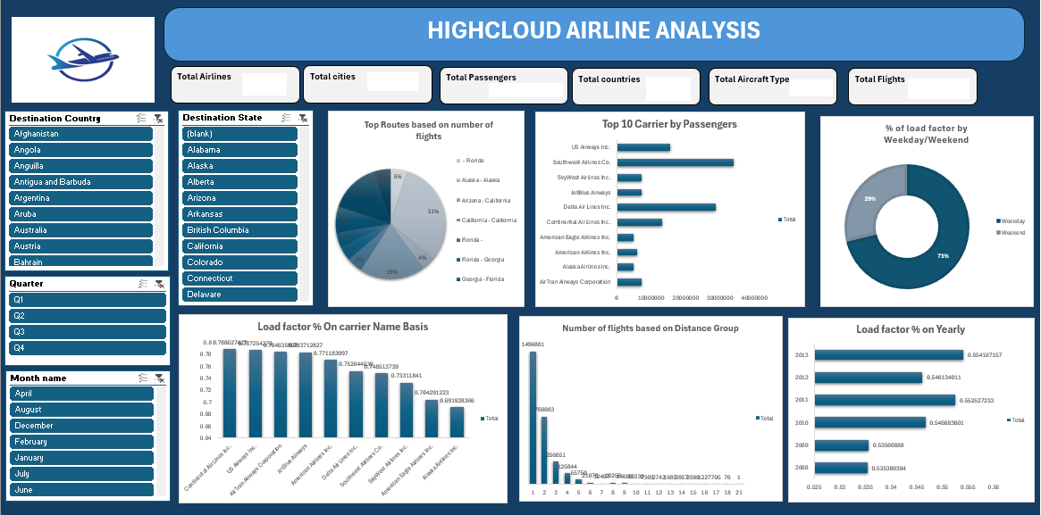
High cloud Airlines Dashboard

Slide 7
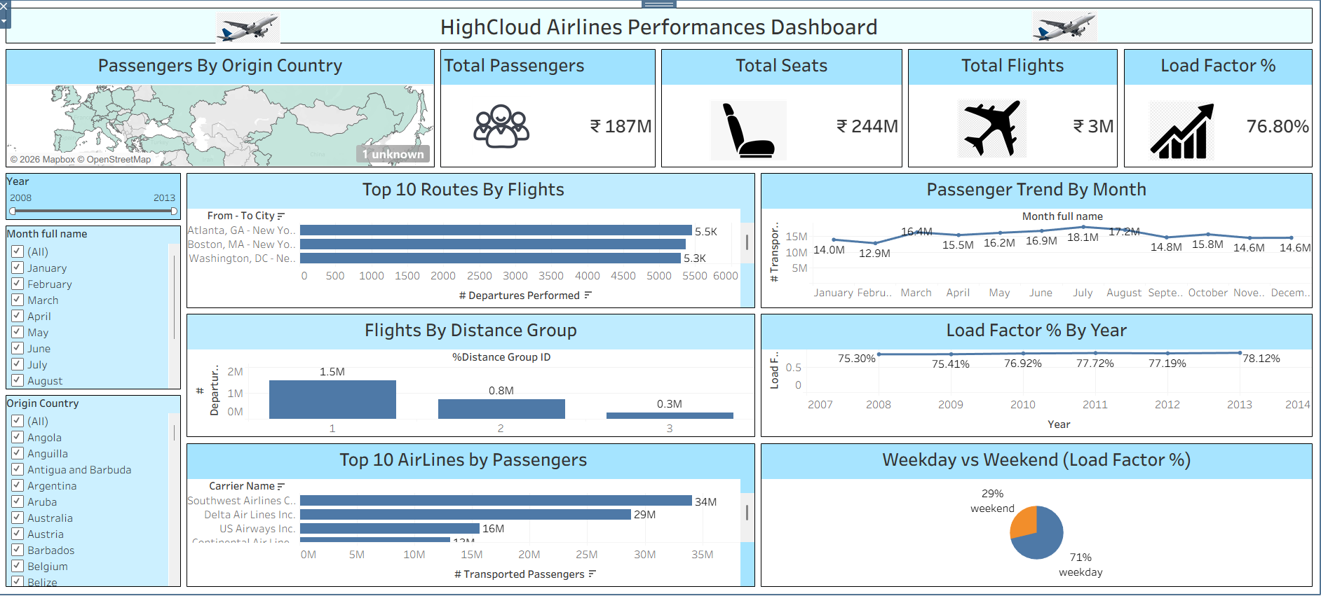
High cloud Airlines Dashboard

Slide 8
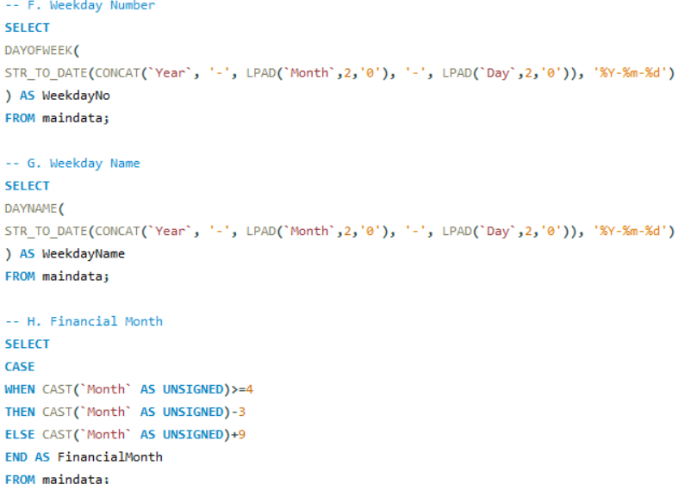
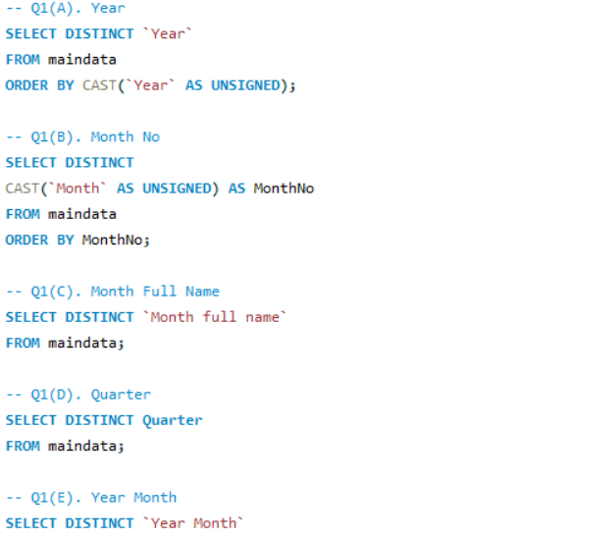
SQL Queries

Slide 9
DAX Calculations & Business Insights
Key DAX Measures
Advanced DAX measures enable dynamic KPI calculations, airline performance analysis, and interactive filtering to provide meaningful business insights.
Key Business Insights
✈️ Top-performing airlines operate the highest number of flights.
📊 Flight delays vary significantly across different carriers and routes.
🌍 Domestic routes generate the majority of flight traffic.
🛫 Certain airports handle the highest passenger and flight volume.
📈 Flight performance trends help identify peak travel periods.
🎯 Interactive dashboards enable faster, data-driven decision-making for airline operations.
Total Flights
Total Flights = COUNTROWS(MainData_Final)
Total passengers
Total Passengers = SUM(MainData_Final[Passengers])
Average Distance
Average Distance = AVERAGE(MainData_Final[Distance])

Slide 10
Challenges, Future Scope & Conclusion
Challenges Faced
Future Enhancements
✈️ Large Flight Datasets
🤖 Predictive Analytics
Handling large volumes of flight data.
Forecast flight delays and passenger demand.
📊 Data Cleaning
Removing missing and duplicate records.
☁️ Real-Time Integration
Connect with live airline databases.
⚡ Dashboard Optimization
Improving Tableau dashboard performance.
📱 Mobile Dashboard
Enable dashboard access on mobile devices.
This project transformed airline data into interactive Tableau dashboards, helping stakeholders monitor KPIs, analyze flight performance, and make data-driven decisions.

Slide 11
Thank You

